Slide 1
Edesia
Sprint Retrospective #5
Team Blue
Adam Bowers | Daniel Wingo | Stephen Bennett | Jonathan Holley
Github: aLotofAdam | 81wingo | stephenbennett2 | mccauley747
UNCG: ajbower3 | dtwingo | scbenne3 | jbholley

Slide 2
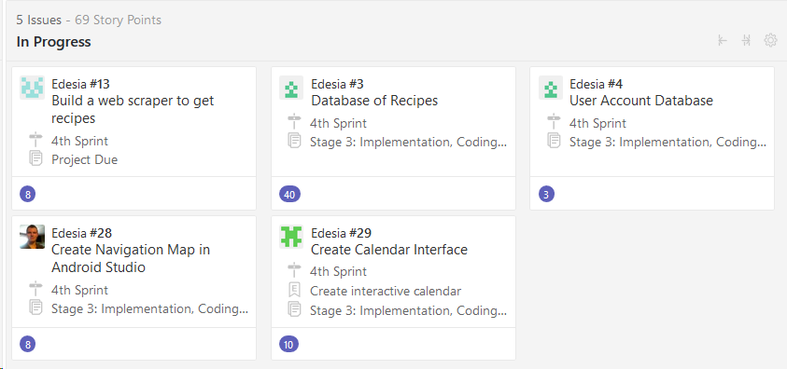
Last Sprint
Create Navigation Map
Create Database for Users and Recipes
Tune-up Web Scraper
Create Calendar Interface

Slide 3
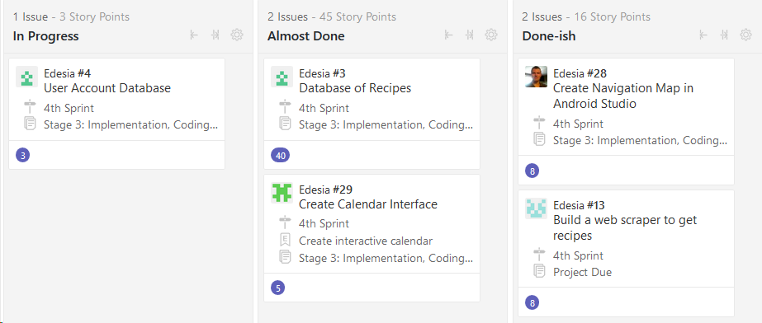
Current Sprint

Slide 4
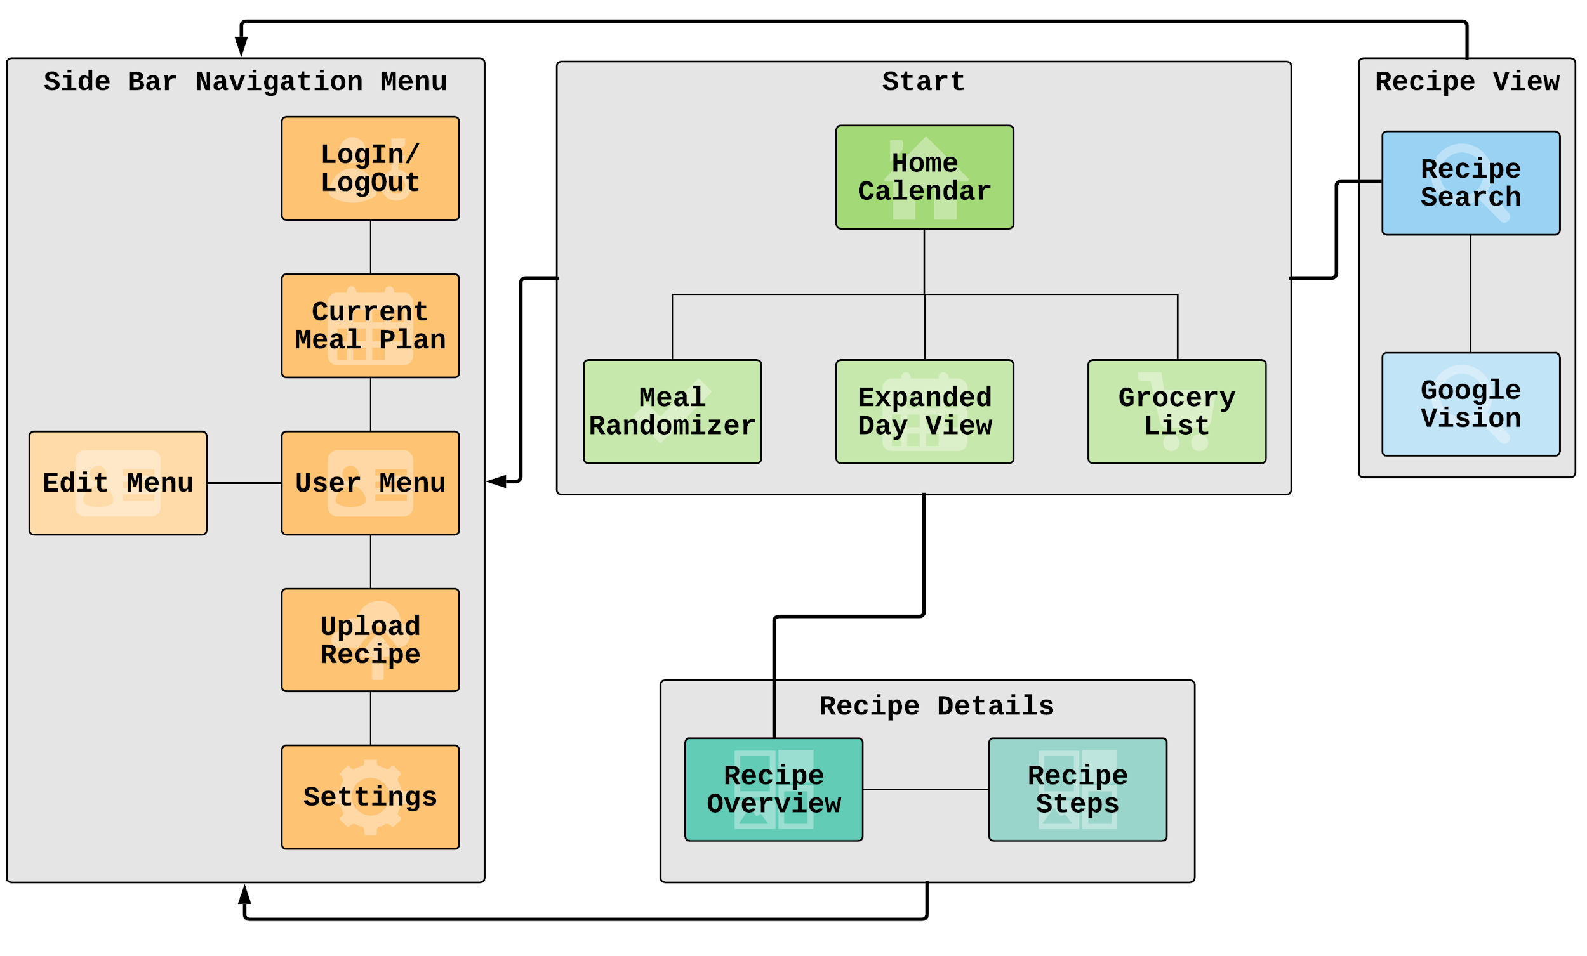
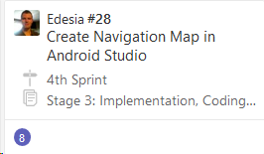
Navigation Map

Slide 5
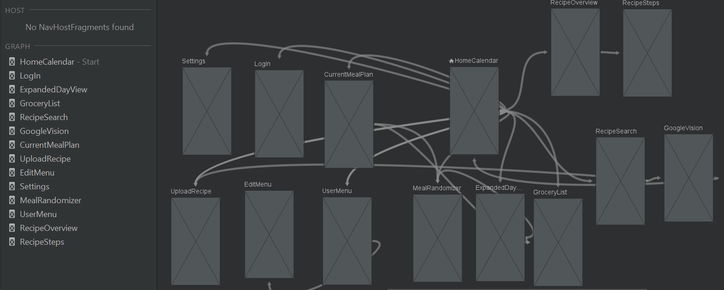
Navigation Map in Android Studio

Slide 6
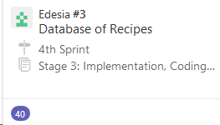
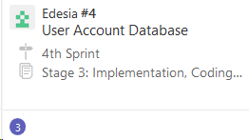
Database
Researching built in functionality of SQLite within AS.
In the process of creating databases, collaborating
with web scraper for specific fields.

Slide 7
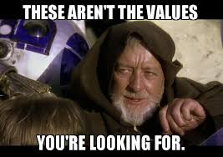
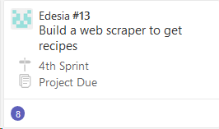
Web Scraper
Research web scraping and string parsing
Can be done so many ways…
Using python.. but unix has many libraries that do it way faster(sed, awk, egrep)
First Web scraper is build it pulls
Recipe title, url, Ingredients, instructions, time
Now time to try and pull images and store in database

Slide 8
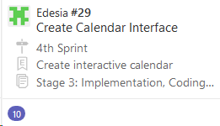
Calendar UI
Revised Mockup
Research...
Android Studio Research
Research...
XML Research
More Research…...

